Slide 1




MASTER PROGRAM IN
DATA SCIENCE AI & MACHINE LEARNING
www.mcta.co.in

Slide 2



Clustering Techniques
www.mcta.co.in
www.mcta.co.in

Slide 3
Contents covered
K-Means
- Clustering algorithm using Euclidean distance formula
2. LDA and PCA
- Linear Discriminant analysis
Identify highly significant variable(s) using Principal component analysis and Latent Dirichlet allocation
www.mcta.co.in

Slide 4
Kmeans
K-means is a form of unsupervised learning algorithm which works in the principle of centroids
It calculates the mean distance between every datapoint using Euclidean distance
In other words, the K-means algorithm identifies k number of centroids, and then allocates every data point to the nearest cluster, while keeping the centroids as small as possible
The ‘means’ in the K-means refers to averaging of the data; that is, finding the centroid.
www.mcta.co.in

Slide 5
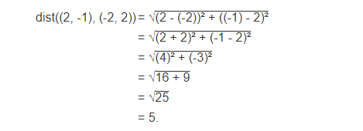
Kmeans
Below is the illustration of Euclidean distance
The distance between 2 point (x,y) and (a,b) is given by
dist((x, y), (a, b)) = √(x - a)² + (y - b)²
Refer to the notebook k-means.ipynb for Python implmentation
www.mcta.co.in

Slide 6
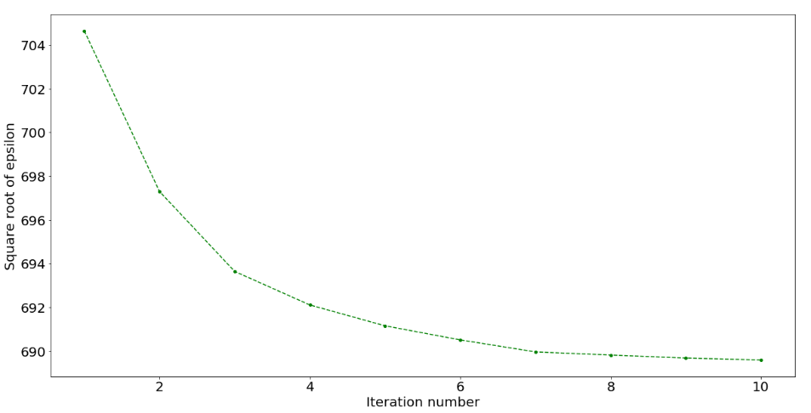
Elbow method
We would be looking at elbow method of K-means clustering algorithm. The elbow method helps to choose the optimum value of ‘k’ (number of clusters) by fitting the model with a range of values of ‘k’. Here we would be using a 2-dimensional data set but the elbow method holds for any multivariate data set.
Let us start by understanding the cost function of K-means clustering. We define cost function of K-means clustering as ‘Epsilon’ which is sum of squares of distance between data points and respective centroid of cluster to which the data point belongs. We expect the cost function to decrease with number of iterations. Let us verify this by plotting square root of Epsilon vs Iteration number.
www.mcta.co.in

Slide 7
Elbow method
As expected value of ‘Epsilon’ decreases with iteration number. We also observe that value of epsilon decreases by small amounts after iteration no. 8 suggesting that the algorithm has almost converged and we can stop with 8 iterations to save computational power and time. The number of iterations the algorithm takes to converge depends on dimensionality of data set and value of ‘k’. Higher the dimensionality of data set and higher the value of ‘k’, more is the number of iterations the algorithm takes to converge.
Now let us fit the model with a range of values of ‘k’ starting from 2 to 5. For each value of ‘k’ the algorithm runs for 15 iterations and cost function ‘Epsilon’ at the end of 15th iteration is calculated.
When we plot the graph of ‘value of k’ on x-axis and ‘value of Epsilon’ on y-axis, there is an elbow formation at the optimum value of ‘k’. Let us check this by plotting the graph of ‘value of k’ vs ‘value of Epsilon’
www.mcta.co.in

Slide 8
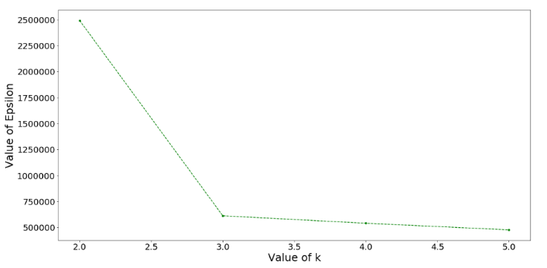
Elbow method
From the above graph we observe that there is an elbow formation at k = 3. Hence the optimum value of k is 3. Therefor we cluster the data set into 3 clusters.
www.mcta.co.in

Slide 9

LDA Linear Discriminant analysis
LDA or Linear discriminant analysis is a dimensionality reduction algorithm used to decrease the number of columns of a given dataset while solving a classification problem
It is mainly used to identify the difference between 2 classes and separate them efficiently while projecting the data in higher dimension space into lower dimension space
For example, we have two classes and we need to separate them efficiently. Classes can have multiple features. Using only a single feature to classify them may result in some overlapping as shown in the below figure. So, we will keep on increasing the number of features for proper classification.
www.mcta.co.in

Slide 10
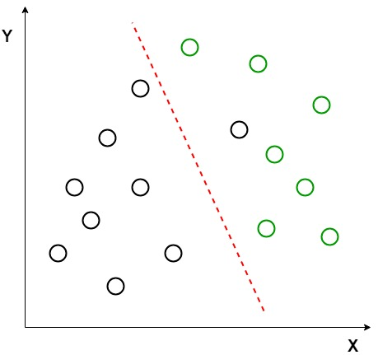
LDA Linear Discriminant analysis
Example: Suppose we have two sets of data points belonging to two different classes that we want to classify. As shown in the given 2D graph, when the data points are plotted on the 2D plane, there’s no straight line that can separate the two classes of the data points completely. Hence, in this case, LDA (Linear Discriminant Analysis) is used which reduces the 2D graph into a 1D graph in order to maximize the separability between the two classes.
www.mcta.co.in

Slide 11
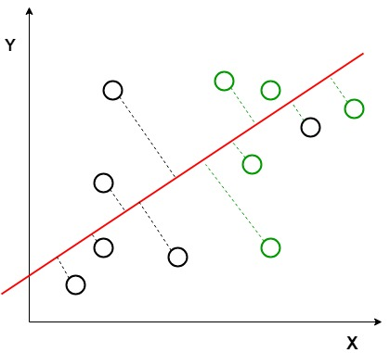
LDA Linear Discriminant analysis
Here, Linear Discriminant Analysis uses both the axes (X and Y) to create a new axis and projects data onto a new axis in a way to maximize the separation of the two categories and hence, reducing the 2D graph into a 1D graph.
Two criteria are used by LDA to create a new axis:
Maximize the distance between means of the two classes.
Minimize the variation within each class.
www.mcta.co.in

Slide 12

LDA Linear Discriminant analysis
In the above graph, it can be seen that a new axis (in red) is generated and plotted in the 2D graph such that it maximizes the distance between the means of the two classes and minimizes the variation within each class. In simple terms, this newly generated axis increases the separation between the dtla points of the two classes. After generating this new axis using the above-mentioned criteria, all the data points of the classes are plotted on this new axis and are shown in the figure given below.
www.mcta.co.in

Slide 13
Latent Dirichlet Allocation
Latent Dirichlet Allocation : is primarily an unsupervised technique used for finding topic distribution. It is based on Dirichlet Allocation and works on based of iteration to find best topic underlying solving using “Joint probabilities”. It is generally used on text data.
Now imagine this DA on documents(text data): Now each document has randomly distributed words, which document picks is (1) like picking dice, getting a “word A” from that document is like getting ‘1’ from dice in (2). So Dirichlet allocation can be used to represent document and words as well.
Coming to LDA now: The basic idea of LDA is to take D X W matrix; D: #documents; W: #words and give D X T and W X T as two output matrices. Where T is #topics.
Choosing T is based on domain or plain finding right T by elbow method.
In many applications you can use D X T matrix, like D X T matrix you can feed to some supervised algorithm like SVM or random forest to classify documents. Whereas W X T matrix you can use to find theme of document.
Refer to ‘lda.html’ for python implementation
www.mcta.co.in

Slide 14
PCA Principle component analysis
PCA finds the principal components of data.
It is often useful to measure data in terms of its principal components rather than on a normal x-y axis. So what are principal components then? They’re the underlying structure in the data. They are the directions where there is the most variance, the directions where the data is most spread out.
PCA finds a new set of dimensions (or a set of basis of views) such that all the dimensions are orthogonal (and hence linearly independent) and ranked according to the variance of data along them. It means more important principle axis occurs first. (more important = more variance/more spread out data)
www.mcta.co.in

Slide 15
PCA Principle component analysis
How does PCA work -
Calculate the covariance matrix X of data points.
Calculate eigen vectors and corresponding eigen values.
Sort the eigen vectors according to their eigen values in decreasing order.
Choose first k eigen vectors and that will be the new k dimensions.
Transform the original n dimensional data points into k dimensions.
Step 1: Normalize the data¶
-. This produces a dataset whose mean is zero.
www.mcta.co.in

Slide 16

PCA Principle component analysis
Step 2: Calculate the covariance matrix¶
Since the dataset we took is 2-dimensional, this will result in a 2x2 Covariance matrix.
Please note that Var[X1] = Cov[X1,X1] and Var[X2] = Cov[X2,X2].
Step 3: Calculate the eigenvalues and eigenvectors¶
Next step is to calculate the eigenvalues and eigenvectors for the covariance matrix. The same is possible because it is a square matrix. ƛ is an eigenvalue for a matrix A if it is a solution of the characteristic equation:
det( ƛI - A ) = 0
www.mcta.co.in

Slide 17
PCA Principle component analysis
Where, I is the identity matrix of the same dimension as A which is a required condition for the matrix subtraction as well in this case and ‘det’ is the determinant of the matrix. For each eigenvalue ƛ, a corresponding eigen-vector v, can be found by solving:
( ƛI - A )v = 0
Step 4: Choosing components and forming a feature vector:¶
We order the eigenvalues from largest to smallest so that it gives us the components in order or significance. Here comes the dimensionality reduction part. If we have a dataset with n variables, then we have the corresponding n eigenvalues and eigenvectors. It turns out that the eigenvector corresponding to the highest eigenvalue is the principal component of the dataset and it is our call as to how many eigenvalues we choose to proceed our analysis with. To reduce the dimensions, we choose the first p eigenvalues and ignore the rest. We do lose out some information in the process, but if the eigenvalues are small, we do not lose much.
www.mcta.co.in

Slide 18
PCA Principle component analysis
Refer to PCA.ipynb for python implementation
www.mcta.co.in

Slide 19
Unsupervised learning
Trivia
Please solve the following questions
Q1) What is k-means
Q2) What is Euclidean distance, write the equation and find the distance between the following points
(3,2) (8,0)
Q3) How is k-means different from KNN
Q4) What is Latent dirichlet analysis
Q5) What is PCA
Q6) List out 4 steps in PCA
www.mcta.co.in

Slide 20

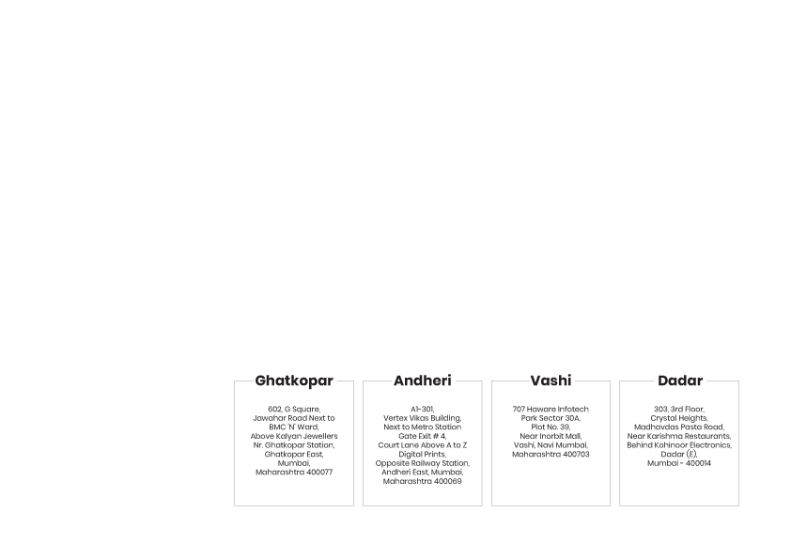
BE AN EXPERT DATA SCIENTIST!
www.mcta.co.in

